Slide 1
Self Organizing Maps
Drew Grier - Cem Tener

Slide 2
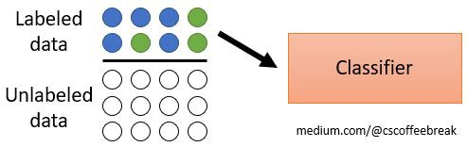
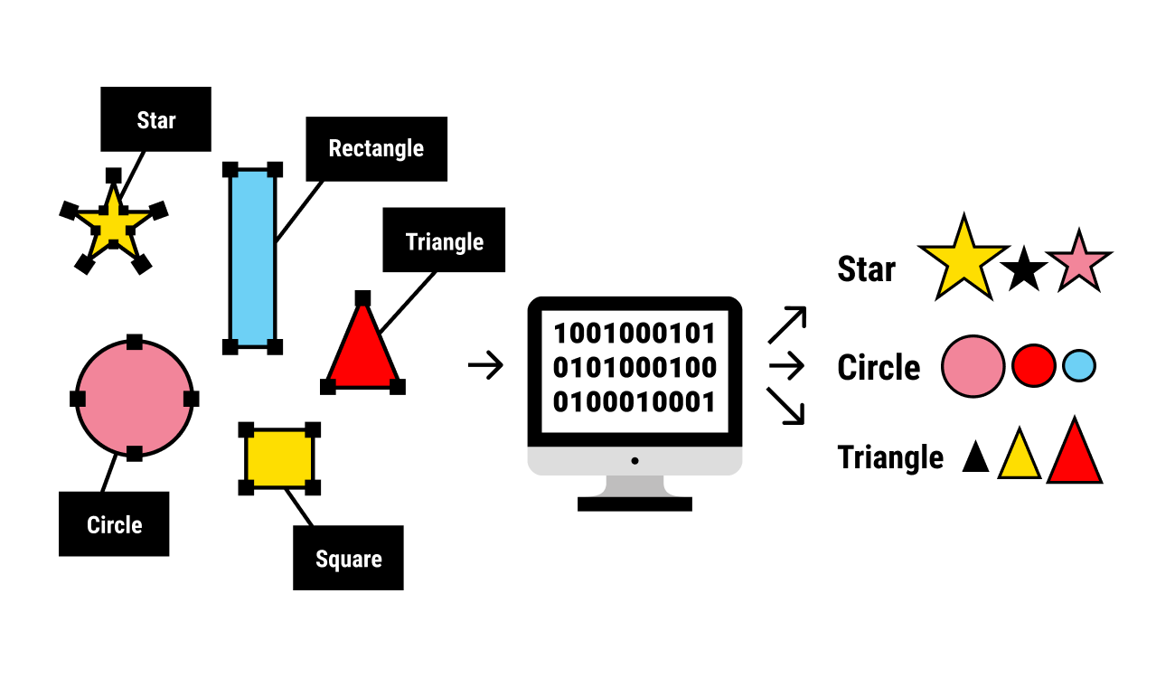
What is a Self Organizing Map?
Machine learning technique used to produce a low-dimensional (typically two-dimensional) representation of a higher dimensional data set while preserving the topological structure of the data.
Two Types
Unsupervised vs Supervised: Supervised learning algorithms are trained using labeled data. Unsupervised learning algorithms are trained using unlabeled data.

Slide 3
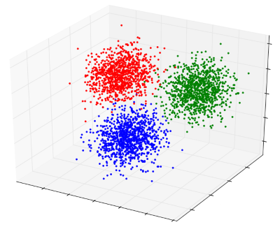
High Dimensional Data
Basic Definition: Number of columns in a data-How many variables you have?
Challenges:
As the number of features in our model increases, the risk of overfitting increases
Clustering becomes more challenging
Trends become harder to detect

Slide 4
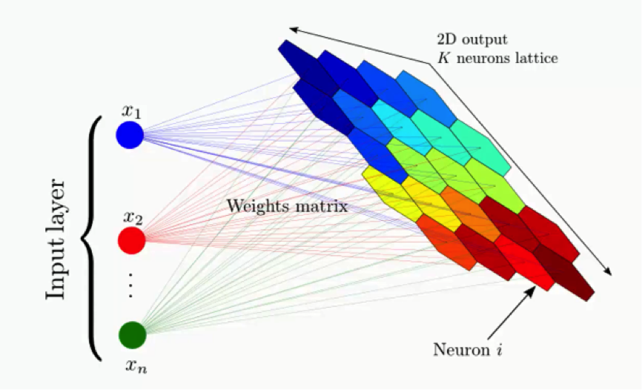
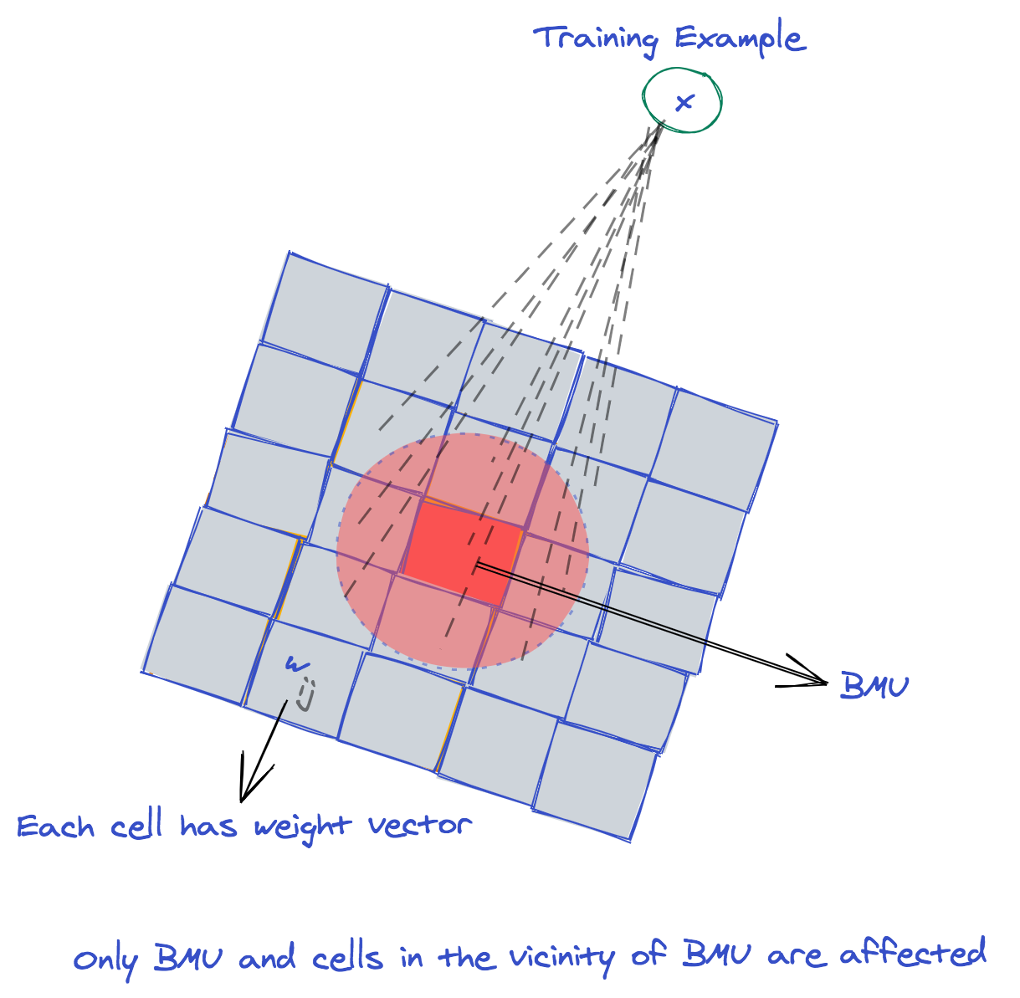
How does it work?
Step 0: Randomly position the grid’s neurons in the data space.
Step 1: Select one data point, either randomly or systematically cycling through the dataset in order
Step 2: Find the neuron that is closest to the chosen data point. This neuron is called the Best Matching Unit (BMU).
Step 3: Move the BMU closer to that data point. The distance moved by the BMU is determined by a learning rate, which decreases after each iteration.
Step 4: Move the BMU’s neighbors closer to that data point as well, with farther away neighbors moving less. Neighbors are identified using a radius around the BMU, and the value for this radius decreases after each iteration.
Step 5: Iterate these steps until positions of neurons have been stabilized.

Slide 5
Normalized vs Unnormalized
Normalization is crucial in plotting more than 1 variables to prevent biases between different observations when determining the BMU.
In supervised learning, we need normalization to make comparisons between training and and validation sets.
Unnormalized scale gives us a better understanding of what range of values go into a cluster.

Slide 6
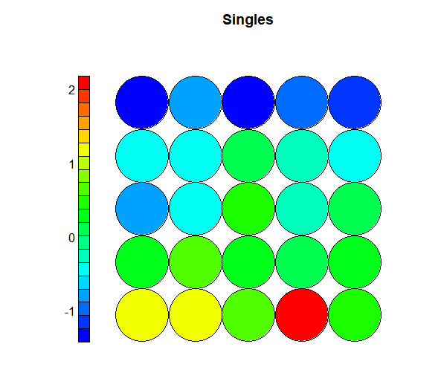
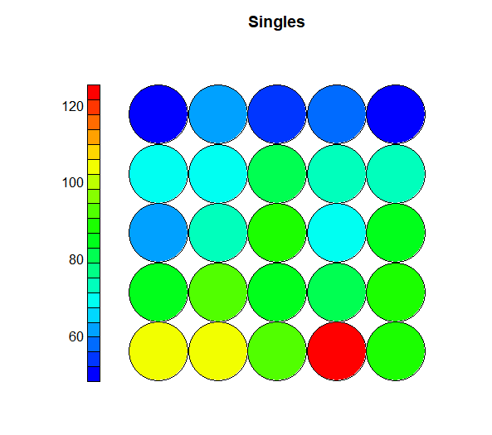
Normalizing vs Not

Slide 7
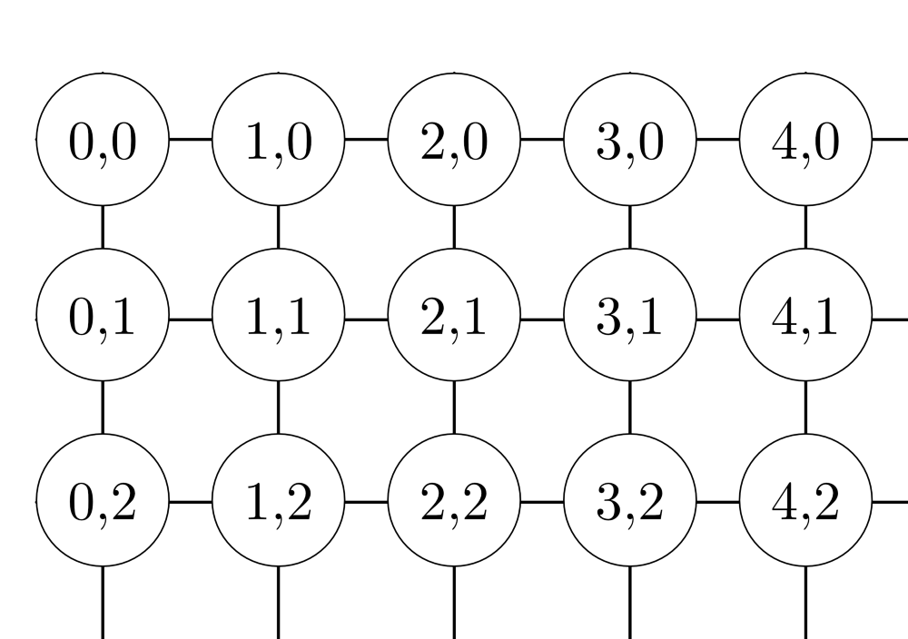
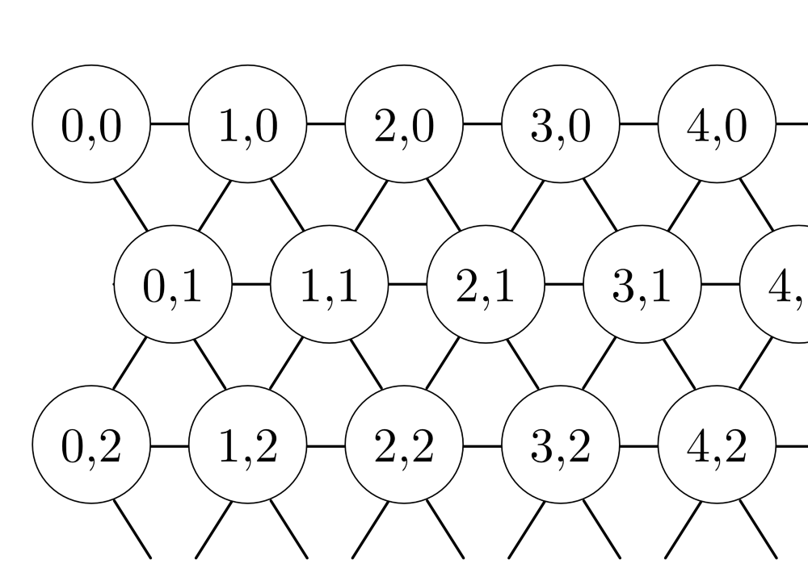
Rectangular vs Hexagonal Grid
Nodes are closer to each other in hexagonal grid than rectangular.
Rectangular is more suitable to detect extreme observations because of the high density on the corners.
We chose to work with the rectangular grid to see the extremes in our data.

Slide 8
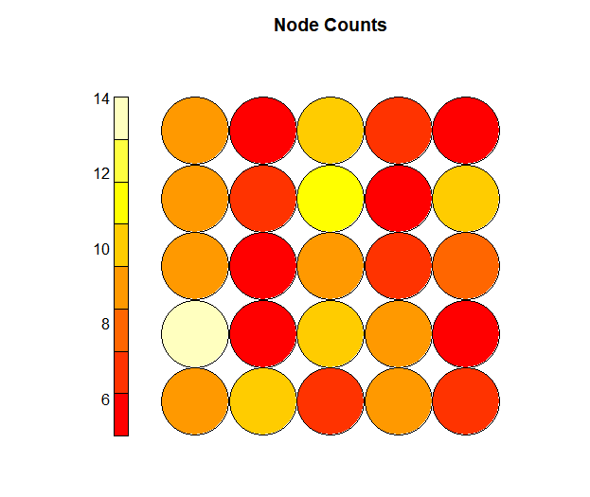
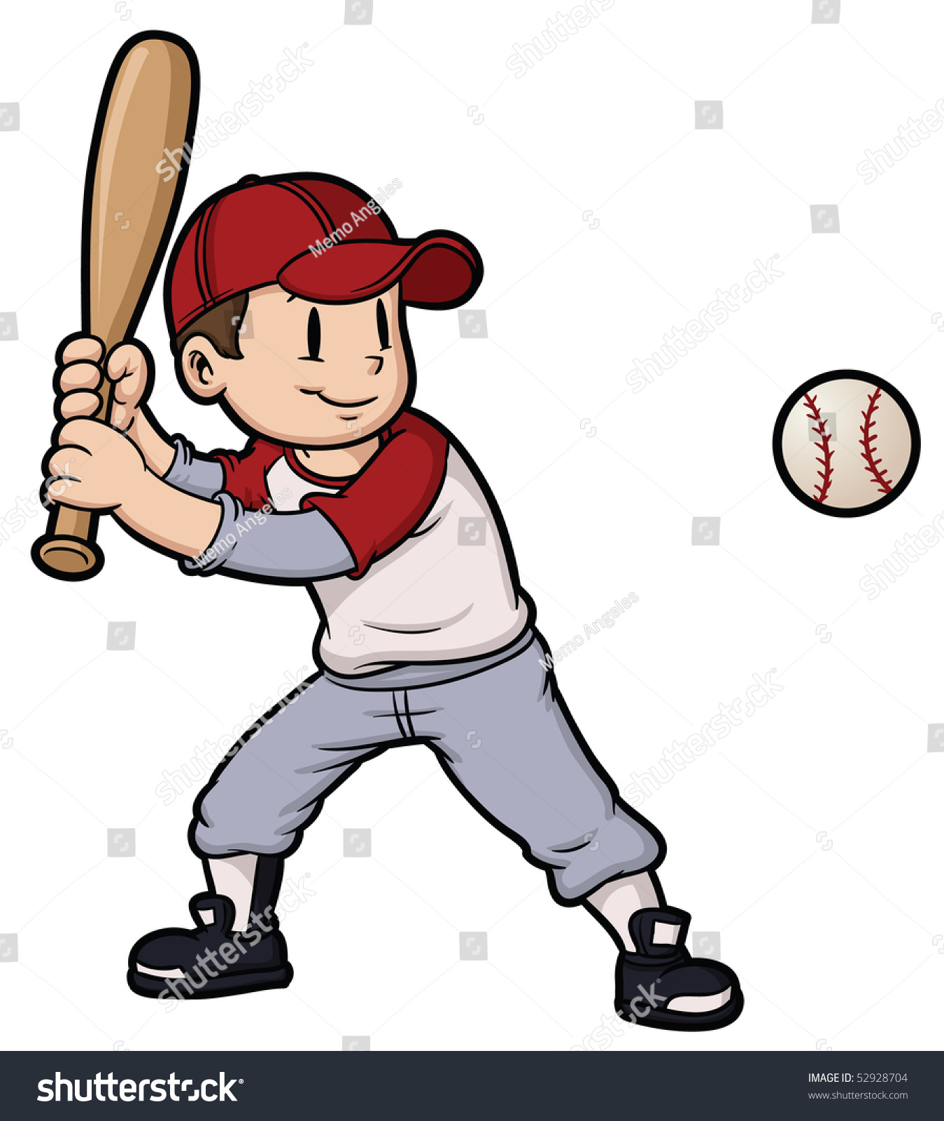
Application in Baseball-Clustering by Hitter Type
Goal: Finding meaningful clusters of hitters in the 2022 MLB season using SOM.

Slide 9
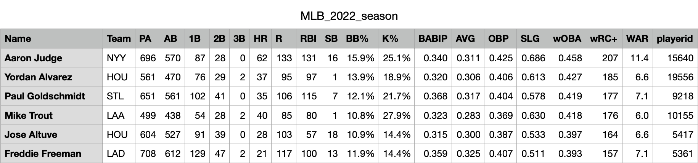
Data Wrangling
We got the data for every player in the MLB 2022 season.
Filtered out players that had less than 400 PA’s.
Selected 8 variables to work/make clusters with which are single, double, triple, home run, batted ball in play average, batting average, on-base-percentage, and slugging percentage.
Normalized each variable to ensure fair “competition” for weighing the vectors.

Slide 10
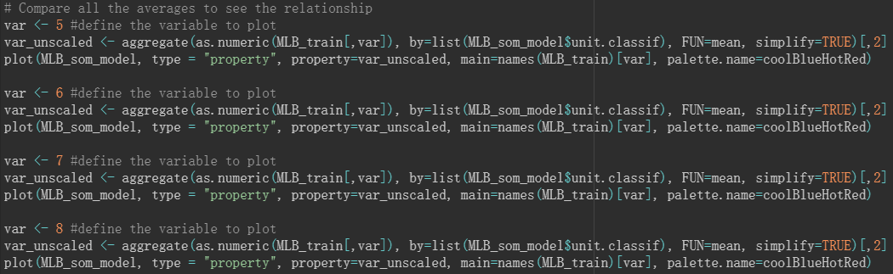
Code for Heatmaps

Slide 11
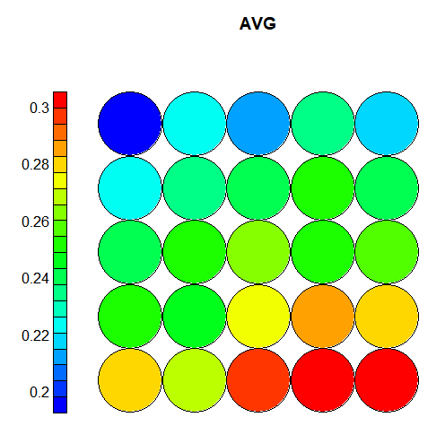
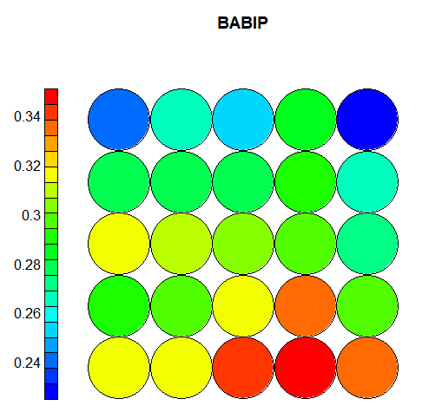
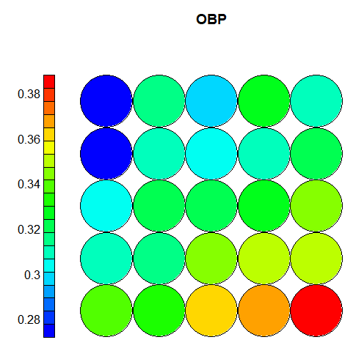
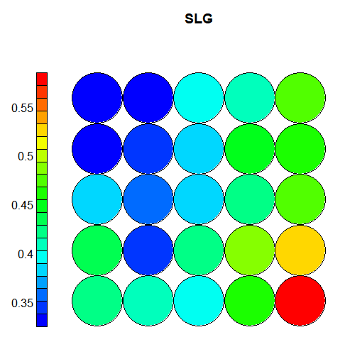
Heatmaps
of
Variables
Each variable is given a heatmap.
This helps us view how they each interact with each other.
We can see some relationships between them.
Notes:
Talk about specific node examples.

Slide 12
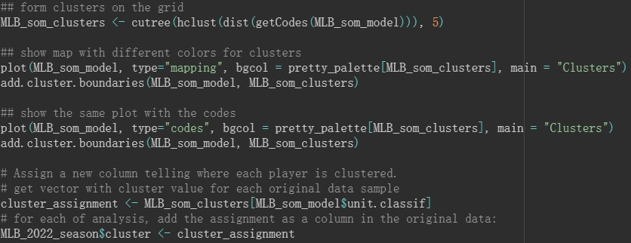
Code to Cluster

Slide 13
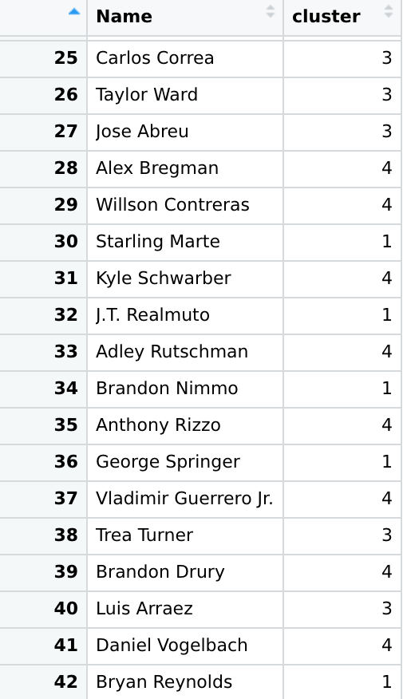
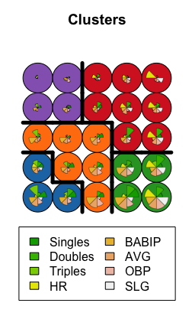
Clustering

Slide 14
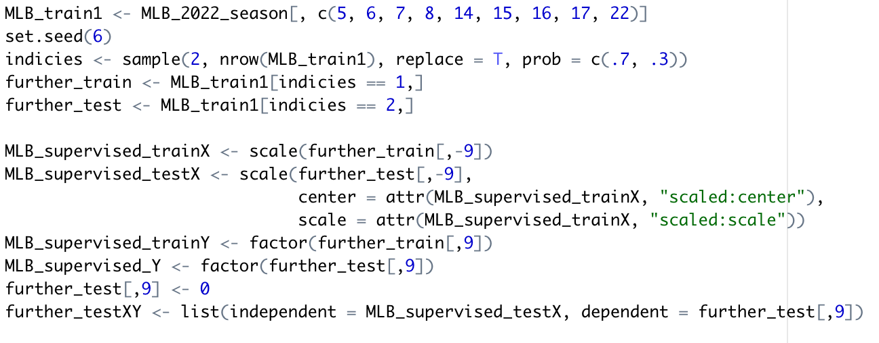
Training Data

Slide 15
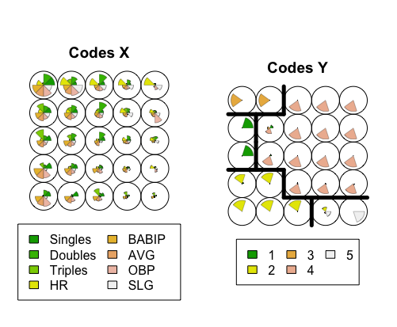
Trained Data Clustering

Slide 16
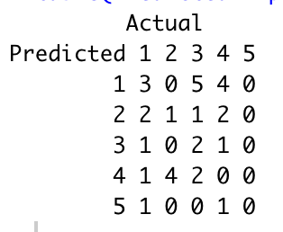
Prediction
Accuracy = 6/31 = 0.1935484

Slide 17
Summary
Self Organizing Maps illustrate multidimensional datasets in 2 dimensional representations.
Vectors from the observations to the nodes on the grid are weighted according to the their corresponding distance
Neighborhoods are recognized within the radius of the BMU
Unsupervised learning = unlabeled data, supervised learning = labeled data
Supervised Learning Methodology:
1. Fit a model 2. Train 3. Predict 4. Improve
YOU CANNOT TRAIN A SUPERVISED LEARNING MODEL BASED ON AN UNSUPERVISED LEARNING MODEL CLUSTERING!!!

